Slide 1

LET'S TALK ONLINE ADVERTISEMENTS

Slide 2


Slide 3

About The Project
Objective
Exploratory data analysis
Parametric tests
Non Parametric tests
Random forests
Conclusion

Slide 4

1.

Slide 5

INTRODUCTION
"Did you know that the average person is exposed to over 5000 advertisements per day?"
The rise of the internet and social media has created new opportunities for businesses to reach potential customers through targeted and personalized ads that appear on websites, social media platforms, and search engines.
Online ads can influence people's buying decisions by promoting products or services that they might be interested in. Advertisers can use various techniques, such as personalized recommendations, limited-time offers, and social proof, to persuade people to make a purchase.

Slide 6

DATA COLLECTION AND DATA ANALYSIs
DATA COLLECTION-
The data was collected by Google forms.
Collection of 378 responses in the survey .
DATA ANALYSIS-
Google Form
MS Excel
R studio
Tableau

Slide 7
OBJECTIVE
To study which kind of advertisements are better at endorsing a product.
To study what factors influences consumers to buy a product.
To study what kind of advertisements attracts which socio demographic factors.

Slide 8
EXPLANATION OF THE VARIABLE INVOLVED
AGE
GENDER
FAMILY INCOME
MARITAL STATUS
ARE YOU A STUDENT.
INFLUENCE OF ONLINE ADS ON PURCHASING PATTERNS
SOCIAL MEDIA.
TRUST ON ONLINE ADVERTISEMENTS.
FACTORS OF AN ADVERTISEMENTS THAT MAKE YOU WATCH IT AGAIN.
APPS OR SITES YOU TRUST THE MOST FOR ADS.
HOW MUCH ADVERTISEMENTS AFFECT YOUR PURCHASE ABILITY.
WHERE YOU VIEW THE ADVERTISEMENTS OFTEN.
ARE ADVERTISEMENTS IMPORTANT.
KINDS OF ADVERTISEMENTS THAT ATRACT/INTEREST.
EVALUATION
INFORMATIVE
PROFESSIONAL
EFFECTIVE
MISLEADING

Slide 9

2.

Slide 10
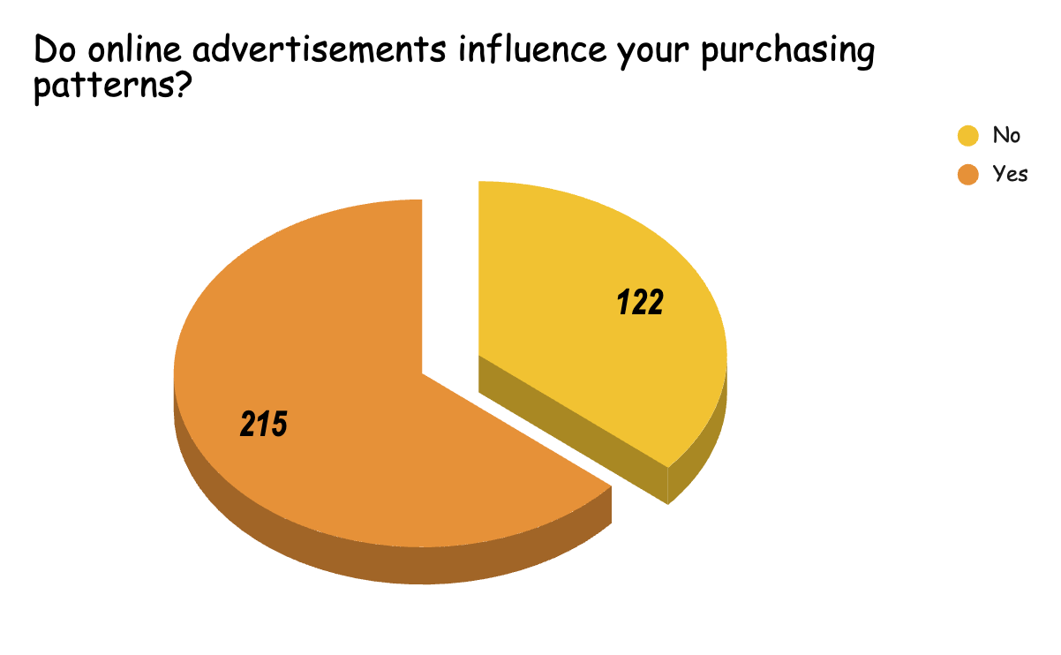
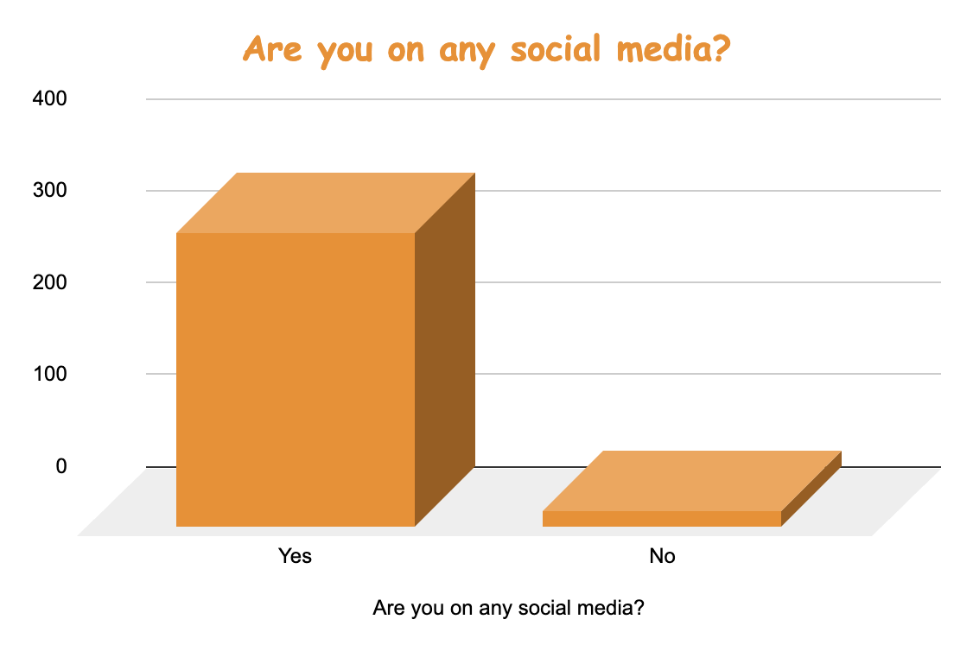
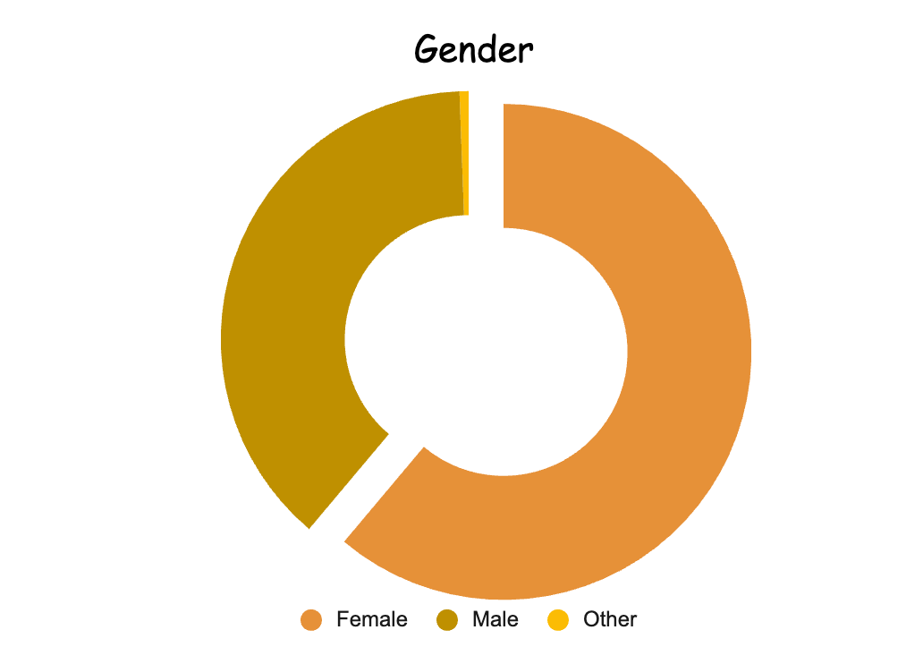

Slide 11
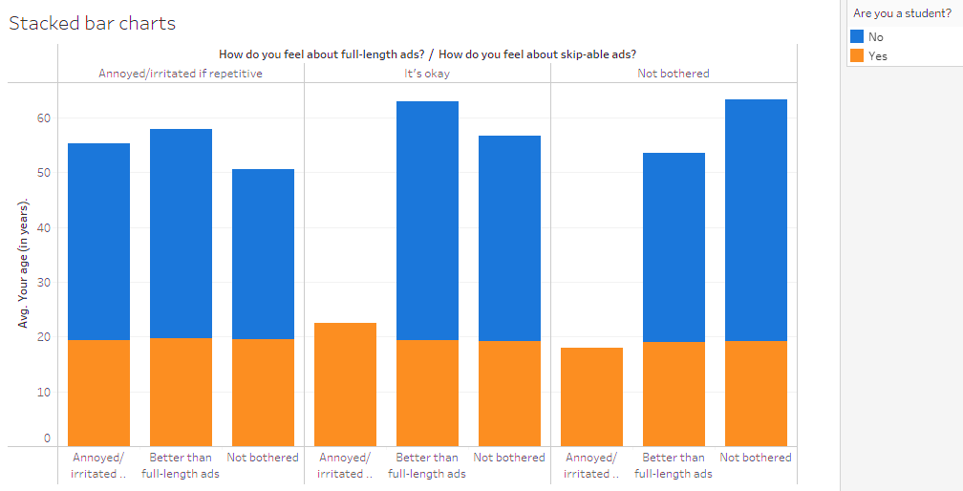
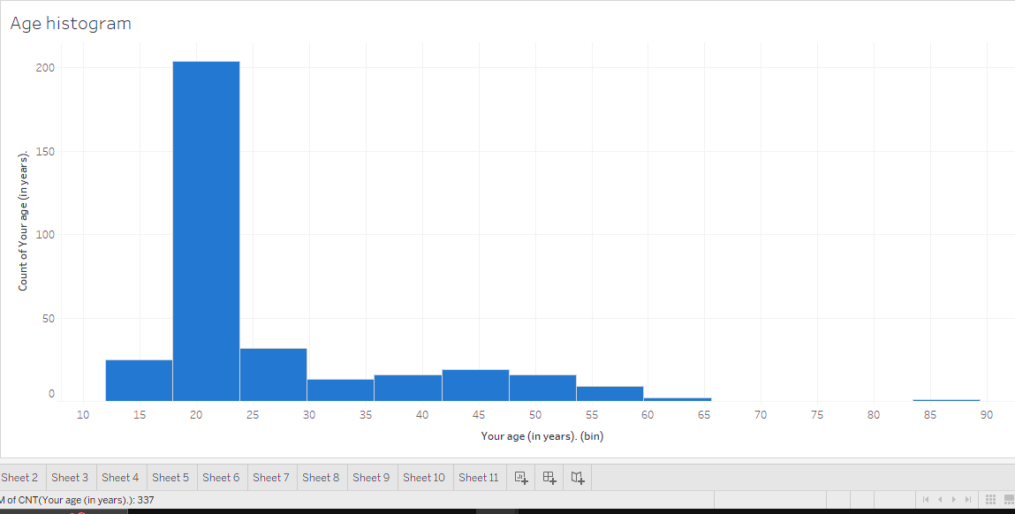

Slide 12
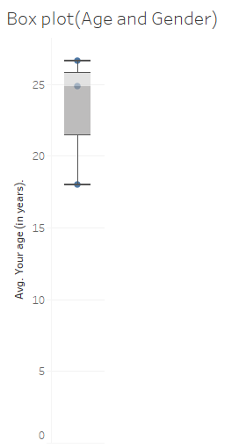

Slide 13

3.

Slide 14


Slide 15

CHI SQUARE TEST
A chi-squared test (also chi-square or χ² test) is a statistical hypothesis test used in the analysis of contingency tables when the sample sizes are large. In simpler terms, this test is primarily used to examine whether two categorical variables (two dimensions of the contingency table) are independent in influencing the test statistic

Slide 16
To Check The Association Between Income and Celebrity Endorsement
Ho : There is no association between income and celebrity endorsement
H1 : Not Ho
Income | Yes | No | Total
<3 | 22 | 37 | 59
3 to 6 | 14 | 38 | 52
6 to 9 | 14 | 26 | 40
9 to 12 | 6 | 19 | 25
12 and above | 14 | 38 | 52
Total | 70 | 158 | 228
Income | yes | no
<3 | 18.11404 | 40.88596
3 to 6 | 15.96491 | 36.03509
6 to 9 | 12.2807 | 27.7193
9 to 12 | 7.675439 | 17.32456
12 and above | 15.96491 | 36.03509
X² | 2.776036
df | 4
p-value | 0.595976
Conclusion:
Since p value > 0.05, we do not reject Ho and conclude that there is no association between income and purchasing a product if celebrity endorses it.

Slide 17
To Check The Association Between Gender and types of products purchased. Ho: There is no association between gender and types of products purchased H1: Not Ho
 | Male | Female | Total
Fashion | 41 | 119 | 160
Beauty | 14 | 95 | 109
Home Products | 21 | 51 | 72
Electronics | 61 | 33 | 94
Food | 40 | 76 | 116
Total | 177 | 374 | 551
 | Male | Female
Fashion | 51.39745917 | 108.6025408
Beauty | 35.01451906 | 73.98548094
Home Products | 23.12885662 | 48.87114338
Electronics | 30.19600726 | 63.80399274
Food | 37.26315789 | 78.73684211
​
X² | 68.56079864
df | 4
p-value | 4.56E-14
Conclusion:
Since p value< 0.05, we reject Ho and conclude that there is association between gender and types of products purchased.

Slide 18
To Check The Association Between Income and price of product affects their purchasing abilities
Ho: There is no association between income and price of product affects their purchasing abilities
H1:There is association
 | price of product affect purchasing abilities
Income | Yes | No | Total
less than3 lacs | 56 | 3 | 59
3 lacs- 6 lacs | 46 | 6 | 52
6 lacs-9 lacs | 38 | 2 | 40
9 lacs-12 lacs | 21 | 4 | 25
12 lacs and above | 50 | 2 | 52
Total | 211 | 17 | 228
 | price of product affect purchasing abilities
Income | Yes | No | Total
less than3 lacs | 54.60087719 | 4.399122807 | 59
3 lacs- 6 lacs | 48.12280702 | 3.877192982 | 52
6 lacs-9 lacs | 37.01754386 | 2.98245614 | 40
9 lacs-12 lacs | 23.13596491 | 1.864035088 | 25
12 lacs and above | 48.12280702 | 3.877192982 | 52
Total | 211 | 17 | 228
p value | 0.2216065234
Chi sq | 5.713302208
df | 4
p value | 0.2216065234
Conclusion :
Since p value > 0.05, we do not reject Ho and conclude that there is no association between income and price of product.

Slide 19
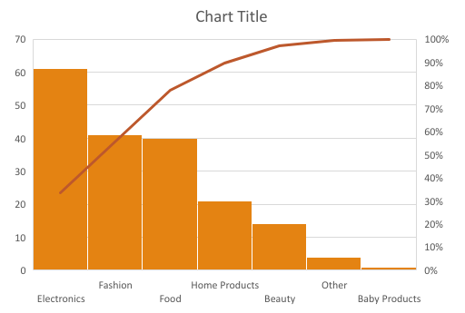
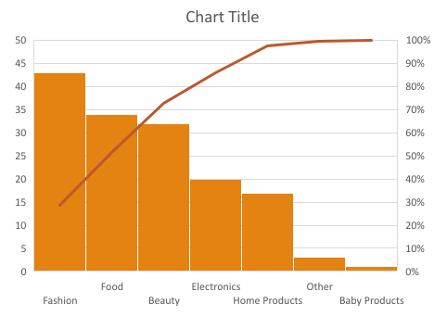
PARETO ANALYSIS
Tendency of People buying products

Slide 20
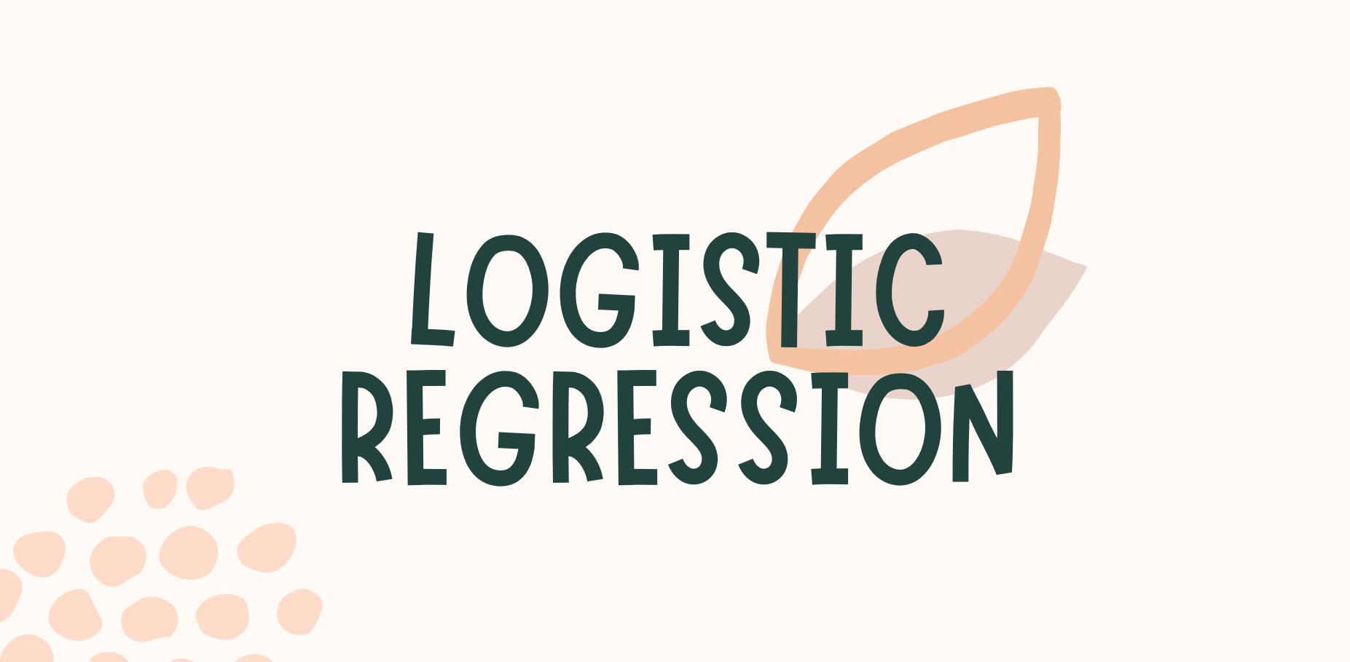

Slide 21
LOGISTIC REGRESSION
Logistic Regression is a type of statistical model that is often used for classification and predictive analytics. Logistic regression estimates the probability of an event occurring, such as voted or didn’t vote, based on a given dataset of independent variables. Since the outcome is a probability, the dependent variable is bounded between 0 and 1.
Assumptions:
1. Logistic regression does not require a linear relationship between the dependent and independent variables.
2. The error terms (residuals) do not need to be normally distributed.
3. Homoscedasticity is not required. And, the dependent variable in logistic regression is not measured on an interval or ratio scale.

Slide 22
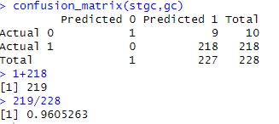
Do you think Advertisement are important
By using Logistic Regression Classifier predicting ads are important.
Features:
Do you think ads are important
Celebrity endorse
Brand name
Brand value
Discount and deals
Customer review
Price information
Awareness of The product
Quality of the product
Result
In conclusion, the model achieved an overall accuracy of 96%, indicating that it correctly predicted the class for 96% of the instances in the dataset.

Slide 23
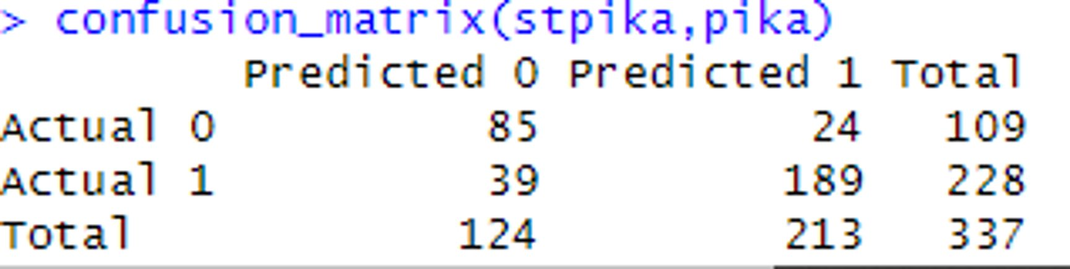
Influence of online advertisements
By using Logistic Regression Classifier predicting influence of online advertisement
Features:
Age
Gender
Occupation
Screen time
Martial status
Results
In conclusion,
the model achieved an overall accuracy of 81%, indicating that it correctly predicted the class for 81% of the instances in the dataset.

Slide 24


Slide 25
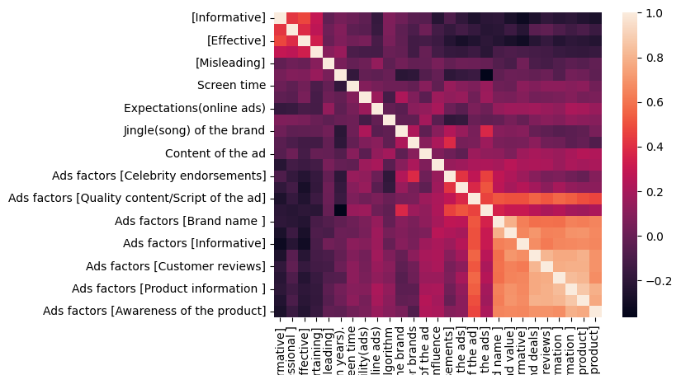
HEAT MAP

Slide 26
CORRELATION
 | [Celebrity endorsements] | [Duration of the ads] | [Quality content/Script of the ad] | [Jingles/motto of the ads] | [Brand name ] | [Brand value] | [Informative] | [Discounts and deals] | [Customer reviews] | [Price information ] | [Product information ] | [Quality of product] | [Awareness of the product]
[Celebrity endorsements] | 1
[Duration of the ads] | 0.415108494 | 1
[Quality content/Script of the ad] | 0.275065599 | 0.372391643 | 1
[Jingles/motto of the ads] | 0.460241414 | 0.511210076 | 0.461624892 | 1
[Brand name ] | 0.279140911 | 0.264348662 | 0.515398458 | 0.353944759 | 1
[Brand value] | 0.225148546 | 0.200091153 | 0.499265977 | 0.303364629 | 0.789709198 | 1
[Informative] | 0.163768604 | 0.243383162 | 0.502428448 | 0.303516489 | 0.636374396 | 0.657268547 | 1
[Discounts and deals] | 0.103076752 | 0.187227403 | 0.555807352 | 0.254064837 | 0.588362644 | 0.704354582 | 0.679800059 | 1
[Customer reviews] | 0.05403666 | 0.114858998 | 0.516067033 | 0.21372151 | 0.59408005 | 0.641597279 | 0.620154566 | 0.808295759 | 1
[Price information ] | 0.072036302 | 0.19921814 | 0.565501376 | 0.247987591 | 0.585447378 | 0.645475713 | 0.657646224 | 0.769278505 | 0.779538732 | 1
[Product information ] | 0.027076153 | 0.131961146 | 0.540851501 | 0.192979353 | 0.639249672 | 0.696046384 | 0.661698487 | 0.770659114 | 0.788855685 | 0.8310547 | 1
[Quality of product] | -0.005589398 | 0.109732103 | 0.496979282 | 0.175778187 | 0.630357406 | 0.70135904 | 0.672812176 | 0.79494593 | 0.789545369 | 0.808822159 | 0.871049871 | 1
[Awareness of the product] | 0.093368221 | 0.113906251 | 0.471829166 | 0.214655057 | 0.651091565 | 0.659589866 | 0.656427231 | 0.692884111 | 0.69509631 | 0.67705505 | 0.791677701 | 0.76589861 | 1

Slide 27

4.

Slide 28
KRUSKAL WALLIS TEST
Assumptions:
1. One independent variable with two or more levels (independent groups).
2. Ordinal scale, Ratio Scale or Interval scale dependent variables.
3. Your observations should be independent.
4. .All groups should have the same shape distributions.
Ho: The medians of the each group(Age and gender) are equal
H1: not Ho
Reject Ho and conclude there is a statistically significant difference between the groups being compared in the Kruskal-Wallis test.

Slide 29

5.

Slide 30
RANDOM FOREST - DO YOU TRUST ONLINE ADVERTISEMENTs
FEATURE-
Type of Random Forest: Classification
Missing Value imputation is already done.
Number of trees: 500
Number of Variables used at each split: 3
Do you trust online ads Online ads_expect ads_popup
Brand_influence cele_influence fav_cele
Purchasing_ability try_new matter_price
Endro_price script_ads eva_info
Eva_prof eva_eff eva_ent
Eva_misleading

Slide 31
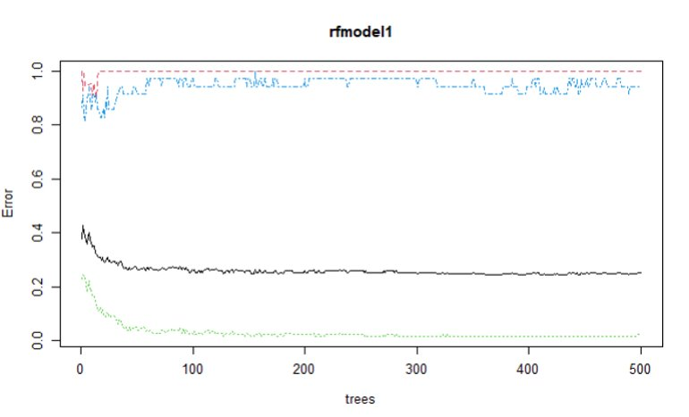
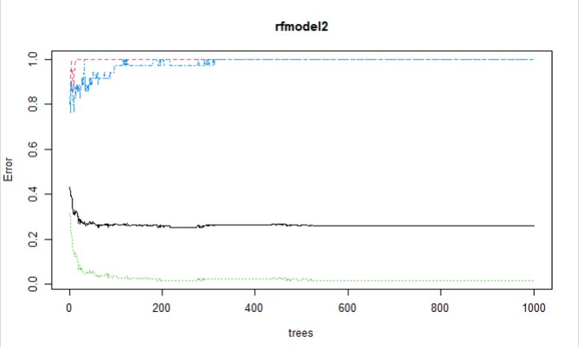
RESULT
no​ | Some of them​ | yes​
0​ | 21​ | 0​
1​ | 168​ | 3​
0​ | 33​ | 2​
Accuracy | 74.56%

Slide 32


Slide 33
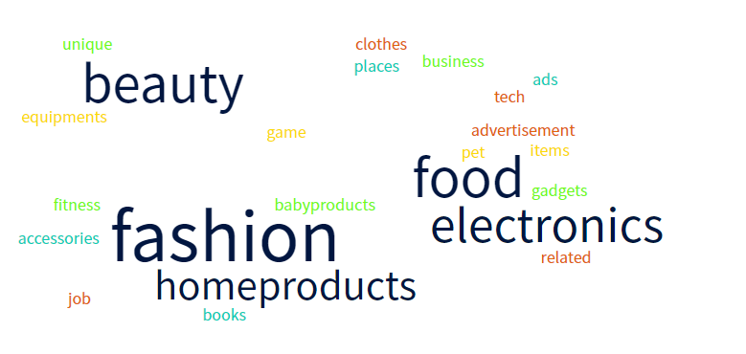
KINDS OF ADS ATTRACTS YOU THE MOST

Slide 34
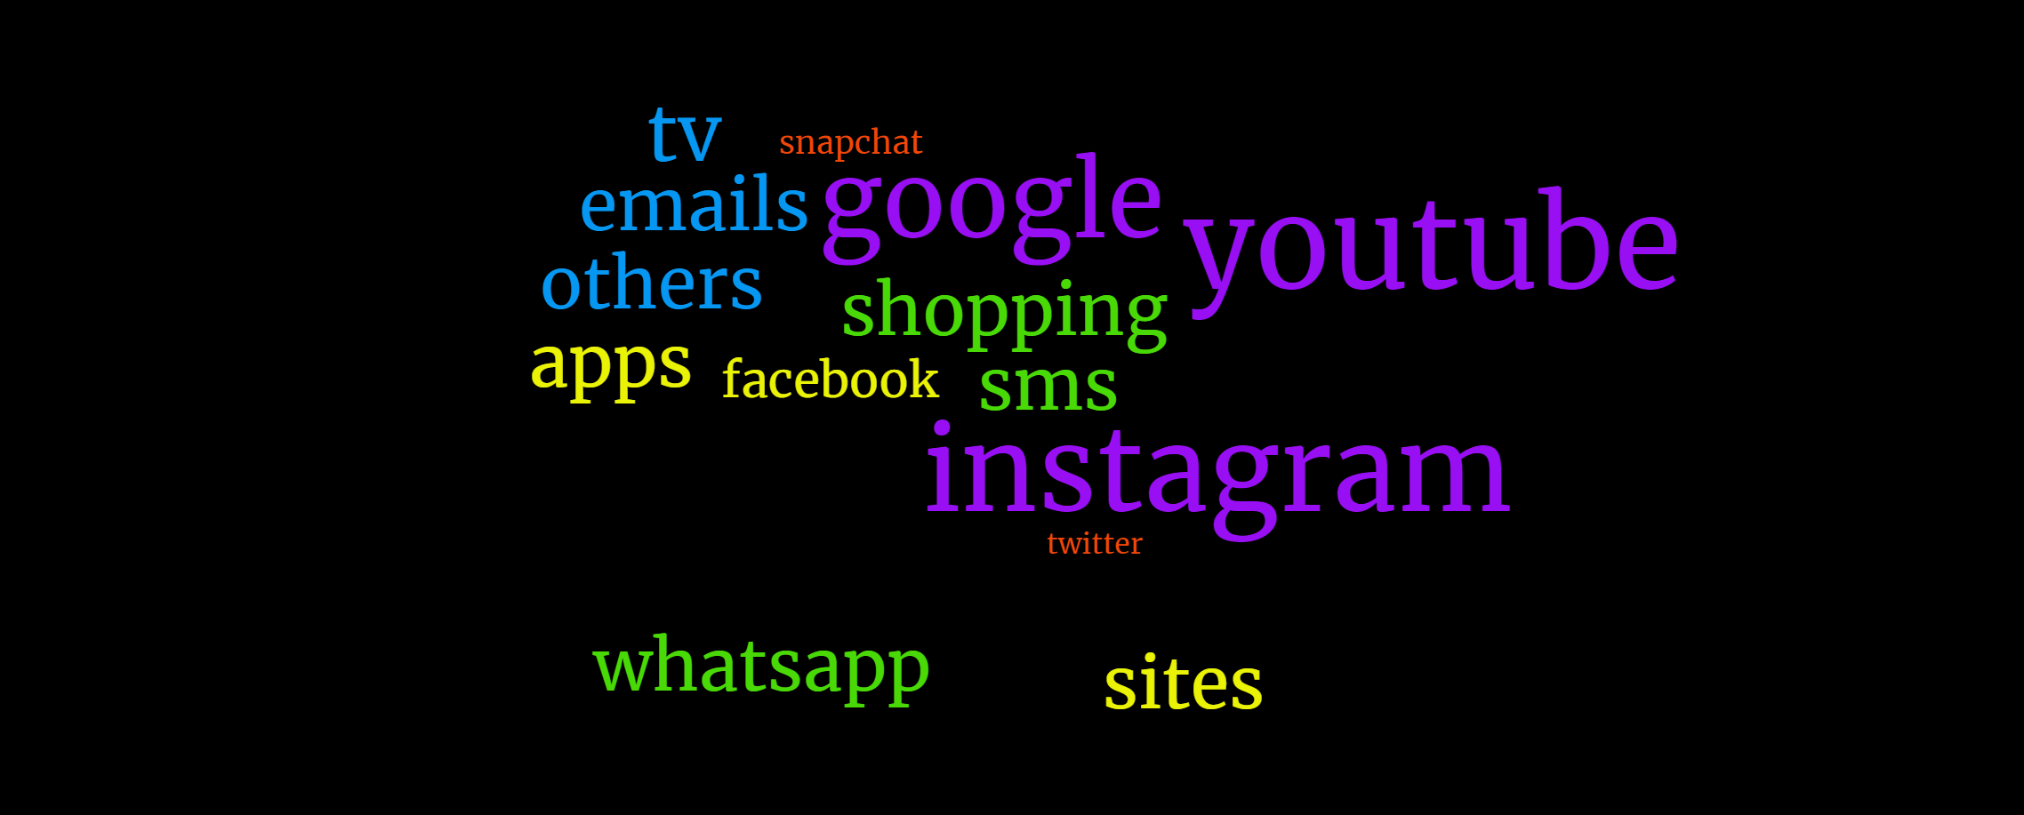
TRUSTED APPS FOR ADVERTISEMENTS

Slide 35

6.
According to the word cloud, we could say that fashion, food, beauty, electronics were the kinds of ads that attracted people the most.
Through correlation, we found that the most factors were positively correlated. i.e: factors like product information, price information, customers etc were the factors that influenced consumers to buy the product.
With the help of Chi- square test, we found that there is no association between gender and type of products purchased
Through Kruskal Wallis test we could see that gender and factors were not identical and also age and factors were not identical.

